Slide 1
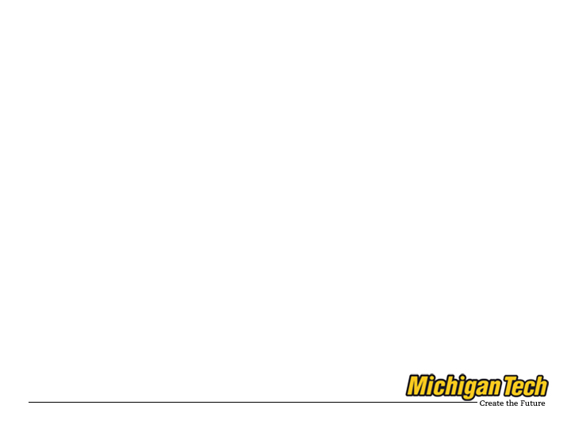
Introduction to Program Slicing
Presenter:
M. Amin Alipour
Software Design Laboratory
http://asd.cs.mtu.edu
malipour@mtu.edu

Slide 2
Outline
What is program slicing
Classifications
Basic Concepts
Basic Algorithms
Challenges
Applications

Slide 3
History
Programs Slicing was introduced by Mark Weiser as his PhD thesis.
He argued that a programmer intuitively tries to slice a program to debug it.

Slide 4

Mark D. Weiser
(July 23, 1952 – April 27, 1999)
He was a chief scientist at Xerox PARC. Weiser is widely considered to be the father of ubiquitous computing, a term he coined in 1988.

Slide 5
What is program slicing?
Informal: “which statements affect value v in statement s”
Formal:
  ”For statement s and variable v, the slice of program P with respect to the slicing criterion <s,v> includes only those statements of P needed to capture the behavior of v at s.”

Slide 6
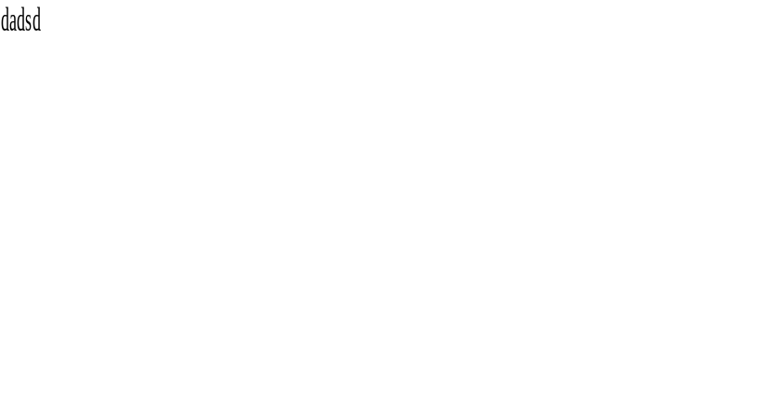
Example
Read(n)
I = 1
Sum = 0
Product = 1
While I<=n do
sum = sum + I
product = product + I
I = I + 1
Endwhile
Write(sum)
Write(product)
Source Code
Read(n)
I = 1
Product = 1
While I<=n do
product = product + I
I = I + 1
Endwhile
Write(product)
Slice for “product” at last statement

Slide 7
Basic Concepts
Control flow graph
  A graph which each node is associated with a statement and the edges represent the flow of control.
  Each node n is associated with two sets REF(n) and DEF(n)

Slide 8
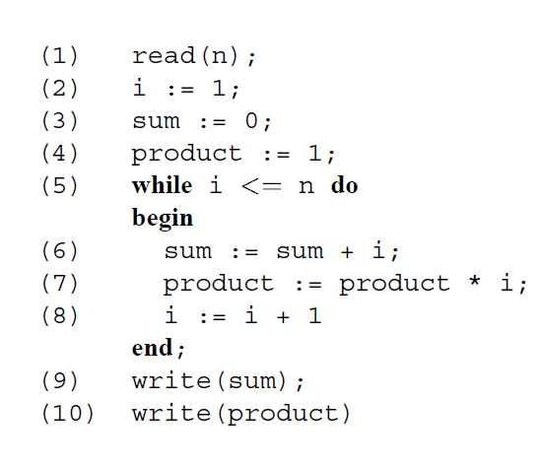
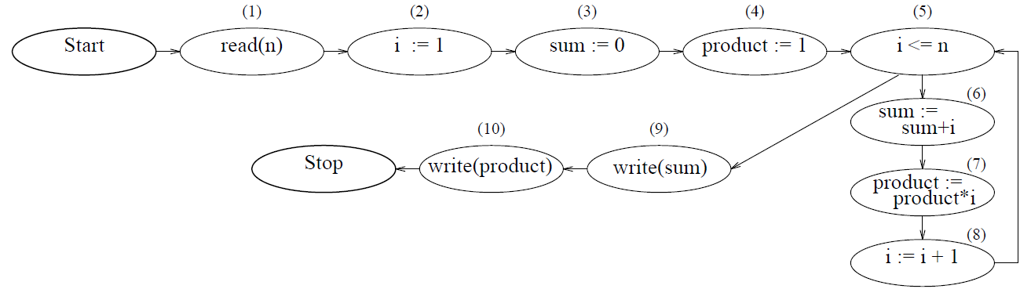
Example

Slide 9
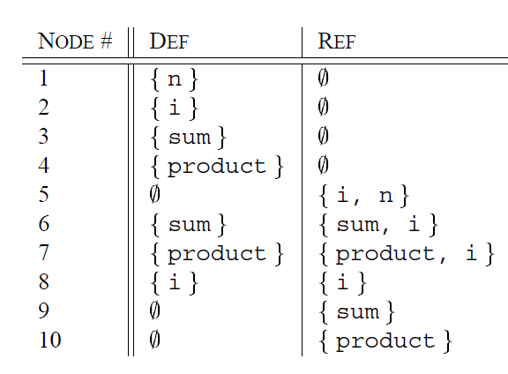
Example Contd.

Slide 10
Basic Concepts-contd
Program Dependence Graph (PDG)
  The vertices of the PDG corresponds to the statements and control predicates,
  The edges corresponds to data and control dependencies.
  It has several variants.

Slide 11
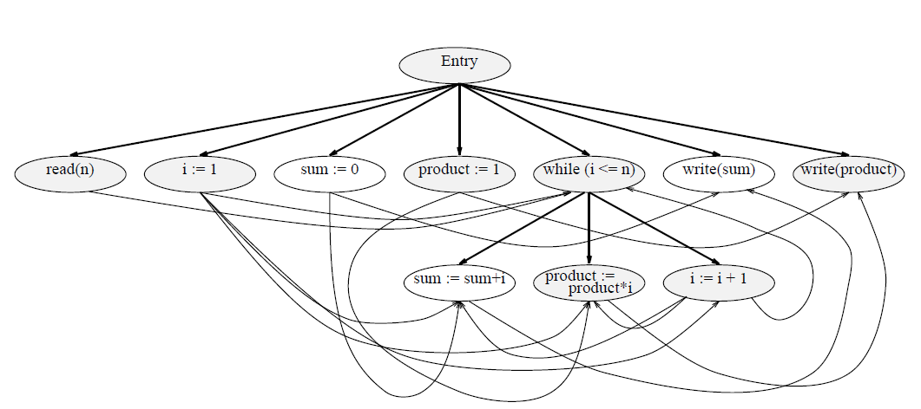
PDG Example

Slide 12
Classifications
Static Slicing vs. Dynamic Slicing vs. Amorphous
Executable vs. Closure
Forward vs. Backward vs. Chopping

Slide 13
Basic Algorithms
Data Flow Equations
Information flow relations
Dependence graph approaches

Slide 14
Data Flow Equations
Statement-minimal slices:
  Slices which no other slices for the same criterion contains fewer statements.
Problem of finding minimal slices is undecidable.
Uses equations alliteratively until it stablizes.

Slide 15
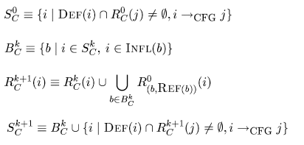
Example of Equations

Slide 16
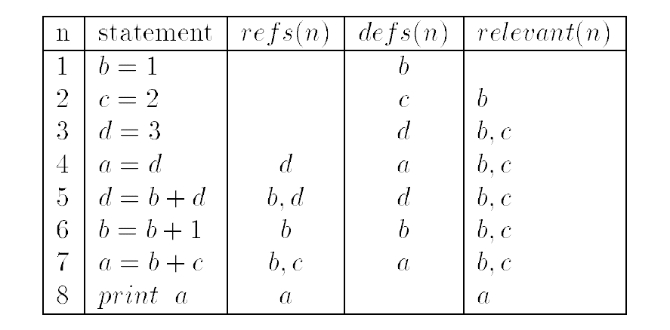
Example:
Relevant Sets for <8, a>

Slide 17
Information-flow relations are computed in a syntax-directed, bottom-up manner.
For a statement (or sequence of statements) S, a variable v, and an expression (i.e., a control predicate or the right-hand side of an assignment) e that occurs in S, the relations , _x0005_λ, ρ and μ are defined.

Slide 18
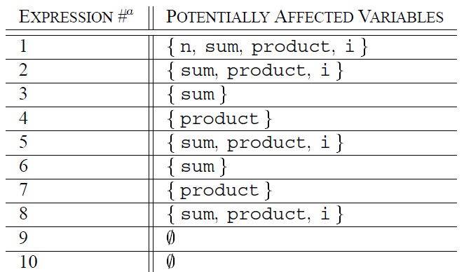
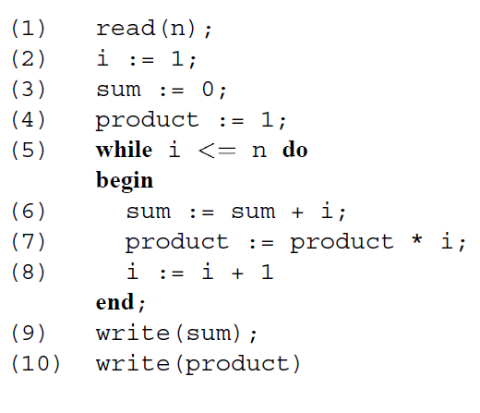
Information-Flow Relation

Slide 19
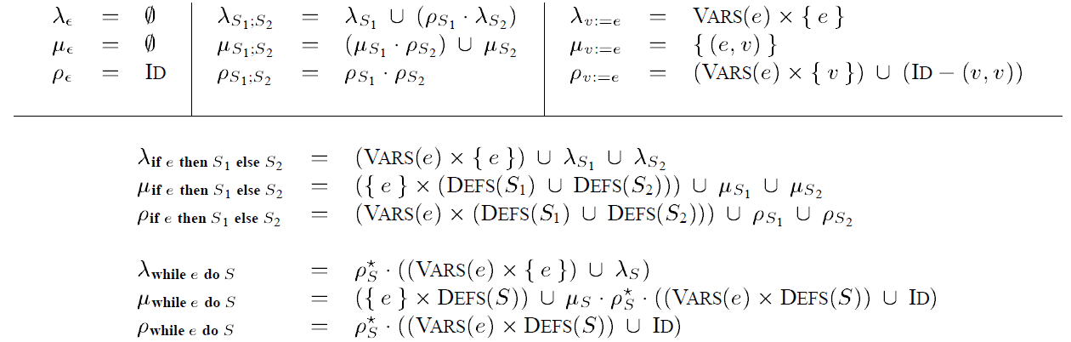
Information-Flow Relation- contd

Slide 20
PDG Example

Slide 21
Challenges
Unstructured programs
  It changes the control flow of program.
Interprocedural Slicing
  Side-effects on global data and Call by references
Arrays and Pointers
  How can determine if a variable is defined or referenced by a pointer
  Having A[f(i)] and A[f(j)], Can f(i)=f(j)?

Slide 22
Concurrency
Concurrency
  It introduces three more dependencies:
    interference dependence
    parallel dependence
    synchronization dependence.
Size
  In almost all applications of program slicing, the smaller the slice the better.

Slide 23
Applications
Debuging
  Finding set of statements that changes a variable of concern.
Software Maintenance
  Slicing helps in understanding of existing software and making changes without having a negative impact.
Testing
  Helps in regression test.

Slide 24
Applications- Cont’d
Differencing
  To capture semantic differences between two programs
...

Slide 25
Some Slicing Tools
Wisconsin Program Slicer (CodeSurfer)
  It can perform forwards and backwards slicing and chopping of C programs.
Unravel
  It perform static backward slicing of C programs.
Kaveri
  It performs static forward and backward slicing and chopping of Java programs.

Slide 26
References
David Binkley, Keith Brian Gallagher: Program Slicing. Advances in Computers 43: 1-50 (1996)
K. Gallagher and D. Binkley. Program Slicing. Frontiers of Software Maintenance, 2008. Beijing, China, October 1-4, 2008.
Tip, F. 1994 A Survey of Program Slicing Techniques.. Technical Report. UMI Order Number: CS-R9438., CWI (Centre for Mathematics and Computer Science).

